Slide 1
INDEPENDENT PROJECT PRESENTATION
Title: ANPR SYSTEM USING RASPBERRY PI
Group Members:
Dheeraj - 2020194
Aryman Srivastava - 2020184

Slide 2
Motivation
ANPR :- Automatic Number Plate Recognition System is a system which follows four different steps to identify the Number Plate of a given Vehicle
The main fields where such systems can be implemented is Security Maintenance, correcting Human Error in recording details, centralizing multiple such implementations, vehicle owner identification incase of any discrepancies.

Slide 3
Problem Statement
The delay time experienced by vehicles entering and exiting through a gate is too long, causing frustration and inconvenience for drivers.
Our goal is to identify strategies and implement the best, that will significantly reduce the delay time for vehicles going in and out of the gate, in order to improve the overall efficiency and convenience of the system.
One of the strategies for improving the efficiency of the entry and exit process, is to implement an Automatic Number Plate Recognition (ANPR) system that uses optical character recognition technology to detect and record the number plates of vehicles entering and exiting the station.
The ANPR system can also be used to stores the entry and exit times of each vehicle, allowing us to track the flow of traffic and optimize the layout and operation of the gate.

Slide 4
Methodology (⅓)
The proposed solution for tracking the movements of vehicles in a designated area involves the development of an ANPR (Automatic Number Plate Recognition) system on a server and the use of a Raspberry Pi and camera module to detect the license plate of vehicles. For this project we have used an Raspberry pi 3b+ Model and an Logitech 720 pixel Camera. The process for this solution is as follows:
The camera, connected to the Raspberry Pi, captures an image of a vehicle as it enters or exits the designated area. For the Camera to click the image, a switch and an Indicator light is installed.
The Raspberry Pi sends the image to the server via a client-server architecture.
The server receives the image and applies the ANPR model to extract the license plate number.

Slide 5
Methodology (2/3)
The ANPR system performs string formatting and checks whether the vehicle is being detected for the first time (i.e. entry) or if it has already been recorded (i.e. exit).
If the vehicle is being detected for the first time, an entry is created in the Excel file with the current time recorded as the entry time. If the vehicle has already been recorded, the current time is recorded as the exit time.
The ANPR system maintains a record of the license plate number, entry time, and exit time of each vehicle in the Excel file.
This solution allows for efficient and automated tracking of the movements of vehicles in a designated area, and can be used for a variety of applications such as security, traffic management, and parking management.

Slide 6
Methodology (3/3)
Camera Module
Raspberry Pi
Server Side
Ouput Save
ANPR (Server Side)
Client Side

Slide 7
Workflow (ANPR System)
1) Getting the Image containing License Plate
2) Passing the Image to the License Plate Detection Model.
3) Region of Interest is extracted from the Model’s result is taken.
4) Sharpening is done to the region of interest for better result.
5) Passing the Region of Interest to the OCR to get the Text containing
License Plate.
6) String formatting is done for better plate recognition and matching.
5) Saving License Plate Number, Entry/Exit time to an Excel Sheet.

Slide 8
Improvements
Many Improvements were done to the model to get a better performance. Some of the improvements include :-
Better trained model for better detection.
Shifted the whole system to Server (IIITD Server).
Implemented Client - Server Architecture to connect Raspberry pi to the Server (IIITD Server).
Minimized the delay between the Client - Server Architecture
Added a manual switch and an LED indicator to click and send images.

Slide 9
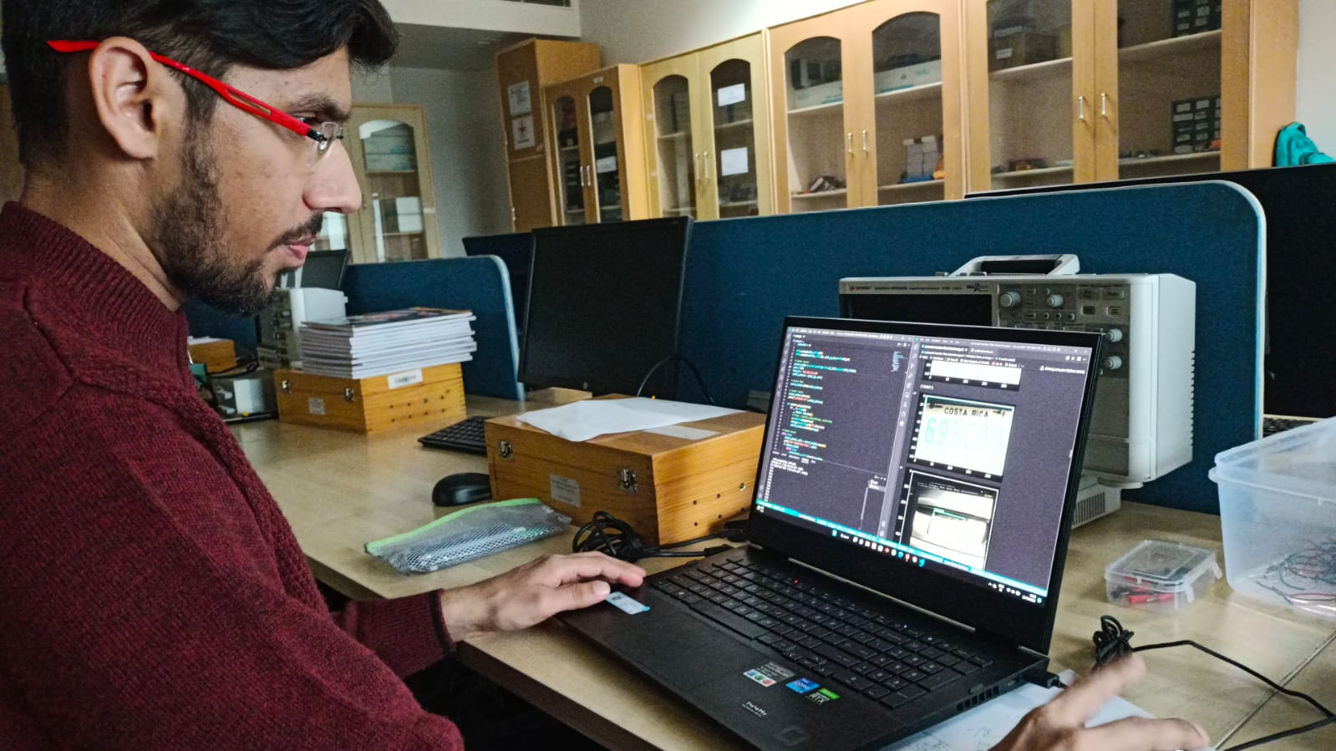
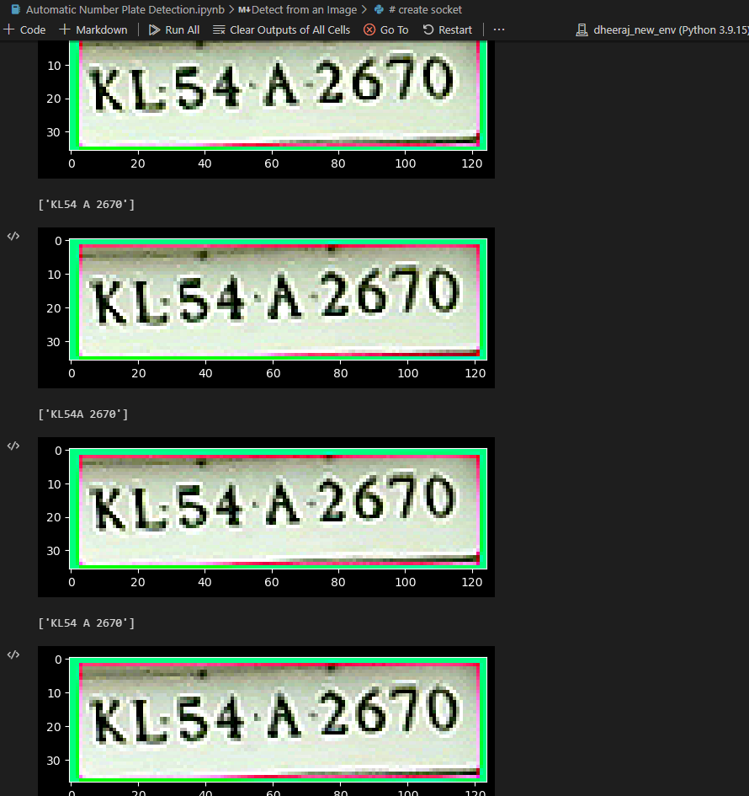
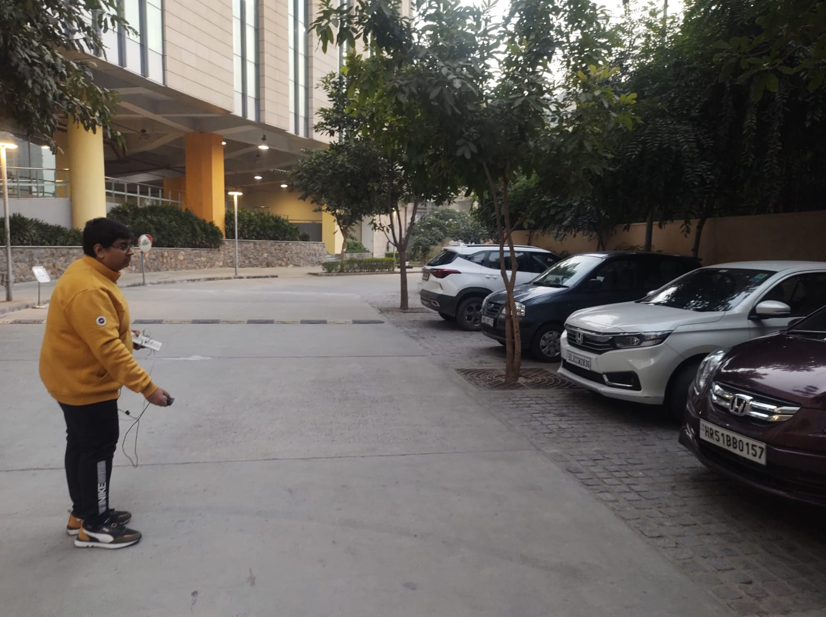
Testing

Slide 10
Results
In order to improve the performance of the model, we have implemented a system that processes a batch of 5 images at once. This process has caused a trade-off between accuracy and speed. It now takes about 3-5 seconds for model to detect number plate from a single image.
In order to further improve the quality of the output, we have also implemented image processing techniques to improve the sharpness of the images and used string formatting to group similar images together.
The accuracy for the image detection is 82-98 % , while the accuracy of the text extraction from image is 80-90%.
A threshold of 80 % was used for both the model and OCR (Optical Character Recognition) was used.

Slide 11
Model chosen by us
TensorFlow 2 detection Model Zoo:
SSd mobileNet V2 FPNLite 320*320 (speed : 22ms , 22.2)
We chose this model because two reasons :
Decent speed
Decent accuracy
EasyOCR for the text extraction from the image due to high speed, and decent accuracy.

Slide 12
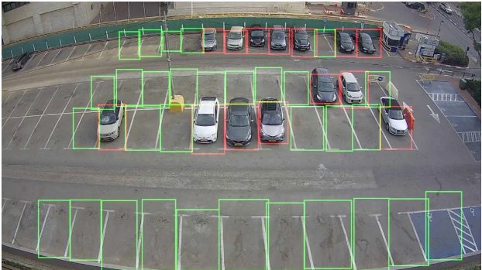
Applications of the projects
The Applications of projects are:-
Parking
Access-Control
Tolling
24 / 7 Security Surveillance
Car Tracking

Slide 13

Future Problems To Be Solved
Reducing the delay of the ANPR model, and increasing the accuracy of OCR.
Automating the process of Image clicking.
Implementing a GUI to enter more details.
Centralizing the system for multiple camera setups.
Expansion of the scope of the model to include two-wheeled vehicles.
Final deployment of the model.

Slide 14
Thank You!

